Slide 1

Project – Part 3 Job Talk INFO 5307: Knowledge Management Tools and Technologies
Venu Gopalan K T
11613143
Notes:
Greetings everyone, I’m Venu Gopalan and This presentation is part of Course INFO 5307 - Knowledge Management Tools and Technologies. This presentation is a Job talk for the Role Senior Data Analyst.

Slide 2
Job Title: Senior Data Analyst
Job Description:
What you will do:
It's an exciting time to join Walmart Global Technology! We are looking for a seasoned Data Analyst who can turn data into information, information into insight and insight into business decisions. Data analyst responsibilities include conducting full lifecycle analysis to include requirements, activities, and design. Data analysts will develop analysis and reporting capabilities. They will monitor performance and quality control plans to identify improvements.

Slide 3
Project – Retail Industry
Title: Customer Behavior (Patterns and Trends)
Aim: To find a purchase pattern / trend in the Customer’s behavior
Dataset: OnlineRetail.xlsx
Notes:
The Project that I worked falls under Retail Industry. My project Title is ‘Customer Behavior (Patterns and Trends)’
In retail industry, it is important to understand the customer needs and meet their standards. The aim of this project is to find patterns in customer behavior and come up with better business proposal. The data set that I used for this project is OnlineRetail.xlsx – from Kaggle.

Slide 4
Working with OnlineRetail.xlsx
Loading data and Changing data types
Exploring and Dividing – based on Countries
Countries used (For Plotting)
- USA - Japan - Italy - Unspecified
- Spain - France - Canada
Adding Map
Summary
Notes:
This is the general outline of my presentation. We will first see how data is modified and divided as per needs, then the plotting with examples, adding Map to the project, few insights and end the presentation with summarizing everything.

Slide 5
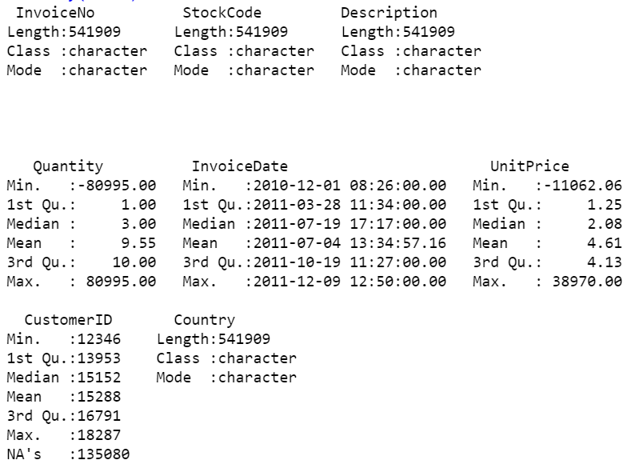
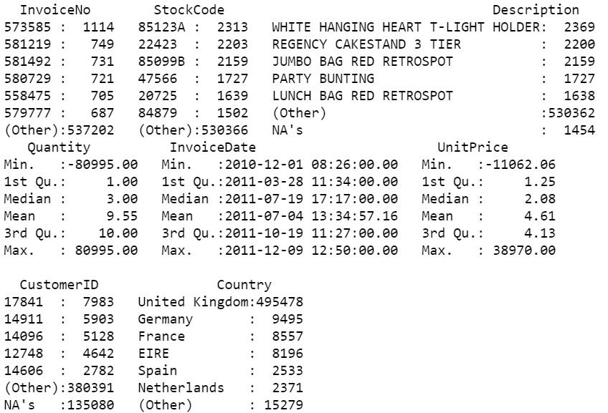
Loading Data and Changing Data Type
Used R and Rstudio
Changed data Type into factor
Notes:
For this project, I used R Language and R Studio.
On the Left, is the original summary of OnlineRetail dataset .
I used a data type factor to modify the data making it easy to work with.
If we look at Right, we can see difference and how factor type conveys more information at a glance, making it efficient to work with.

Slide 6
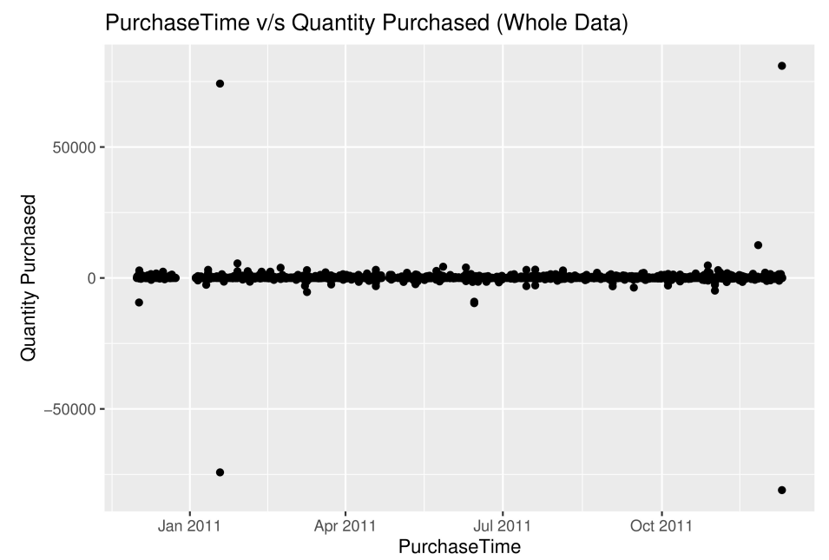
Exploring and Dividing Data – based on Countries
Plotting whole data – Unreadable
Getting Country - specific insights
More accurate and precise results
Notes:
On to your right is the graph of the whole dataset OnlineRetail
Apart from the purchase time of Jan 2011 to Dec 2011 along with maximum quantity purchased, we won’t get any useful information for business decision
So, I divided the data based on countries that we saw earlier and plotted graphs but taking a few of them as example
I chose Country because, for understanding a customer’s preference, the place they are living- their demographic region plays a key role and makes it easy to analyze the preference

Slide 7
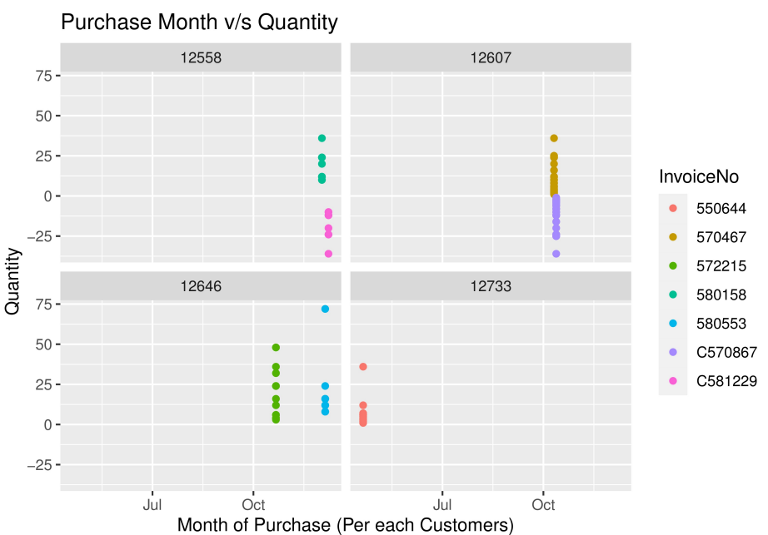
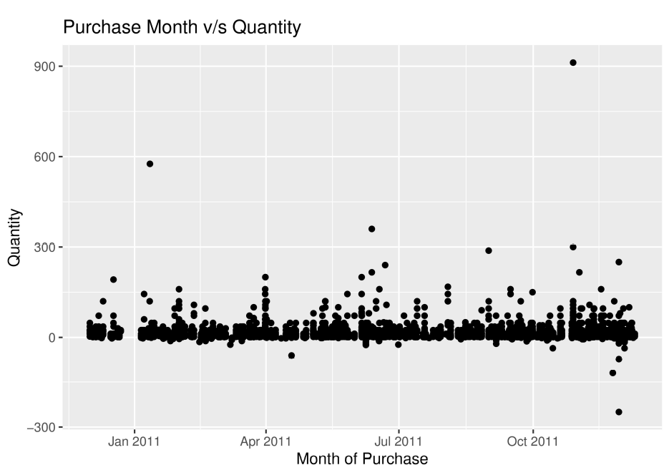
Plotting – Based on Countries
USA
France
291 Entries
4 Customers and 7 Invoices
8557 Entries
88 Customers
Notes:
Following are sample graphs that I used for plotting. I could conclude that US purchases were made only in Winter season because purchase were in Beginning of Year, October and Year End. Whereas for France, it was most of the year.

Slide 8
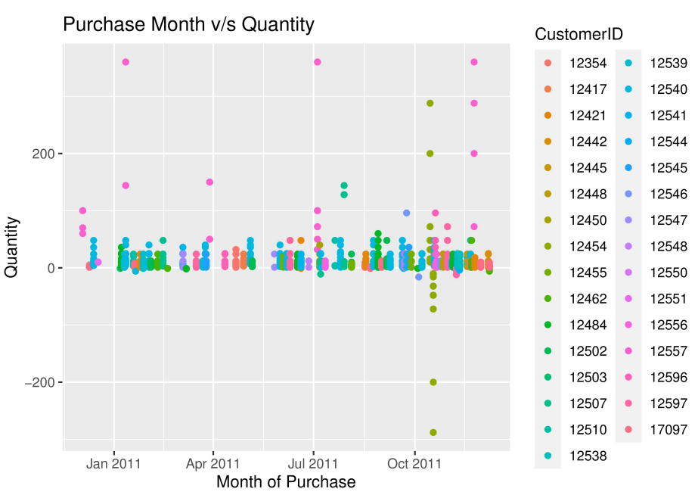
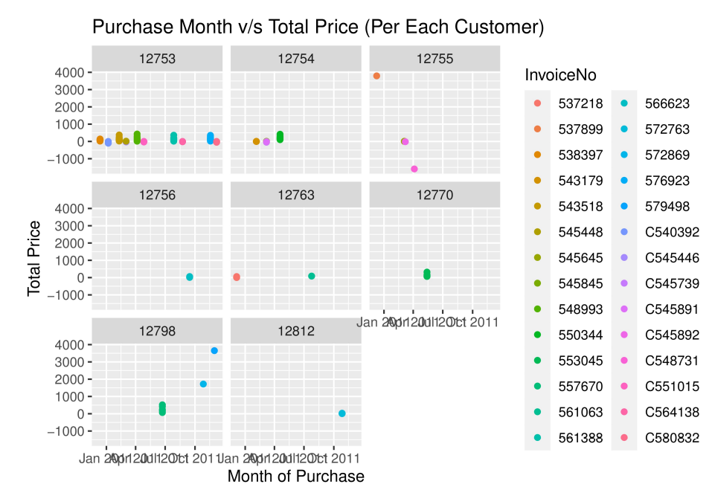
Plotting – Based on Countries (cont.)
Spain
Japan
2533 Entries
31 Customers and 105 Invoices
358 Entries
8 Customers and 28 Invoices
Notes:
These are the example cases where we can understand the data, but it will take time to read the graph and gain knowledge. For Spain, ponts and colors make it hard to read, whereas for Japan, even though we are able to generate individual graph for each customer, the data on the axis line is not readable and points are not precise

Slide 9
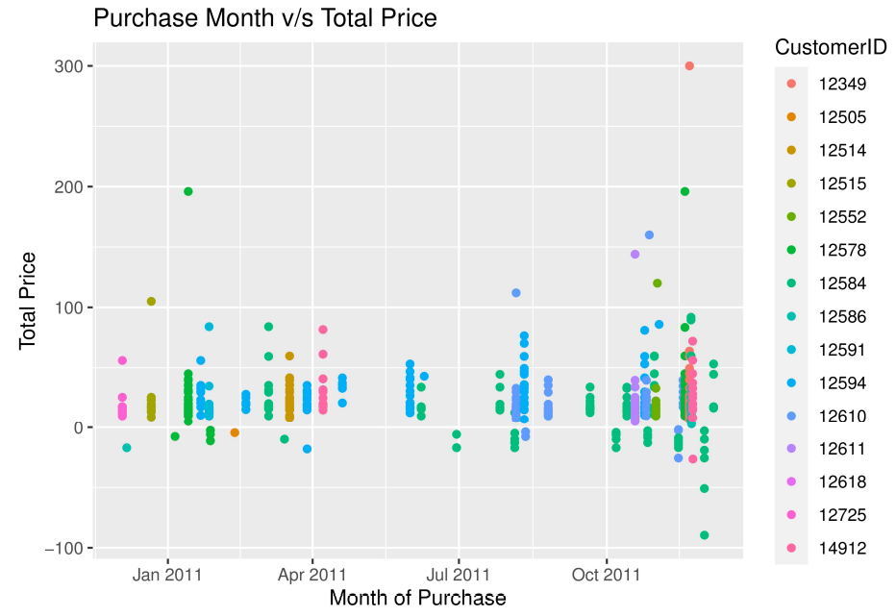
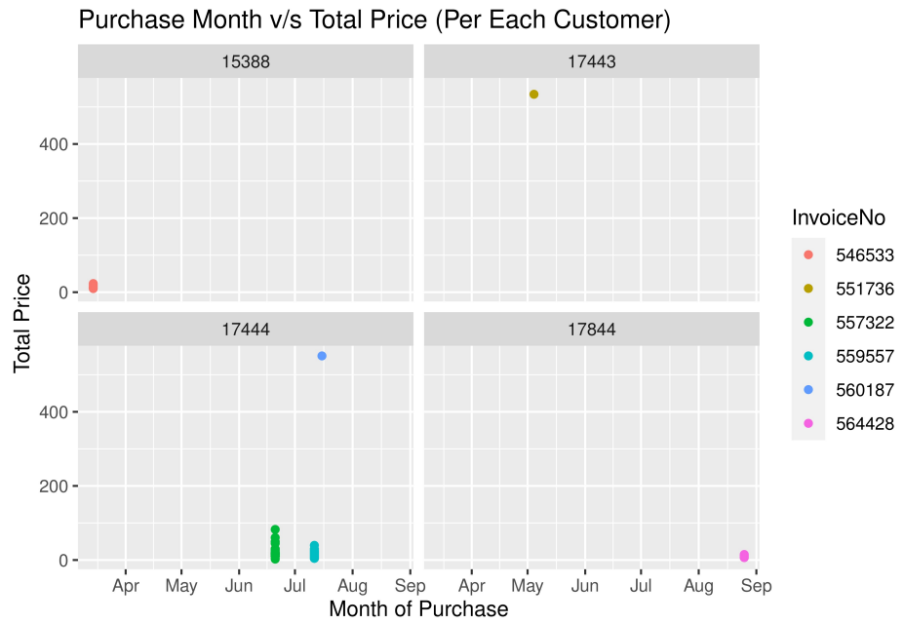
Plotting – Based on Countries (cont.)
Italy
Canada
803 Entries
15 Customers and 55 Invoices
151 Entries
4 Customers and 6 Invoices
Notes:
It was a good choice of not implementing Facets for Italy having 15 customers. We could see understand that there were no purchases in the middle of the year (May, June). For Canada, we can’t draw a strong conclusion because we don’t have enough information. This is a cases where data becomes ineffective because of limited availability

Slide 10
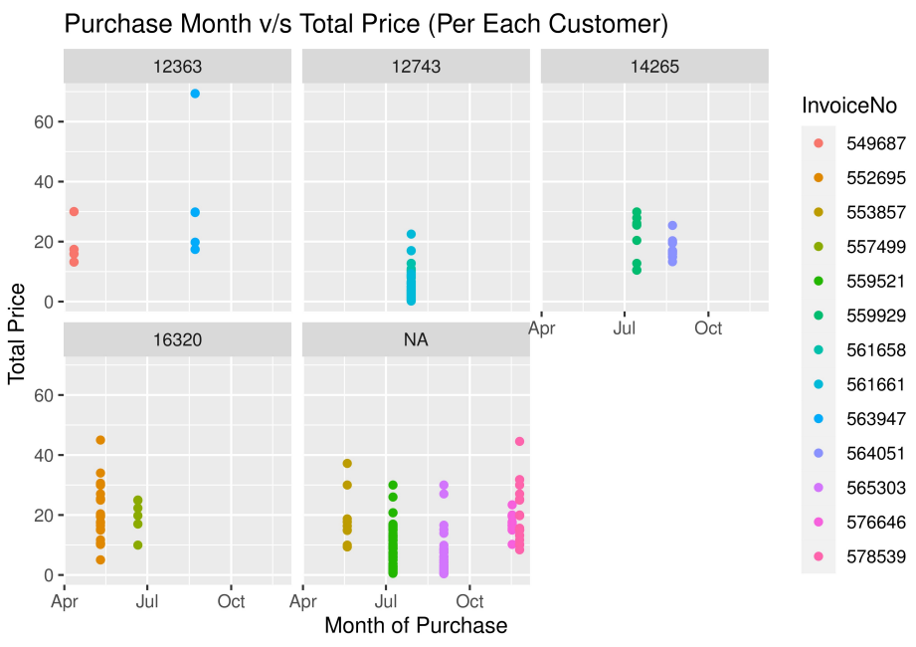
Plotting – Based on Countries (cont.)
Unspecified
446 Entries
4+ Customers and 13 Invoices
Not NA / NULL
Notes:
Here, we have an Observation – Unspecified
This is actually not null value and is similar US, Spain or Japan. It is challenging as these customers may belong to any country and it effects the drawn conclusion. Say for example, if we consider 16320 as a US customer, ‘Winter Purchase’ will turn out false. Also if we look at the last graph, we have Null value. Usually, we have techniques to fix null values such as mean imputation, but we can’t use mean imputation here It can be used only on a quantitative data but Customer ID is a categorical data and we can replace it with the mean of the values.

Slide 11
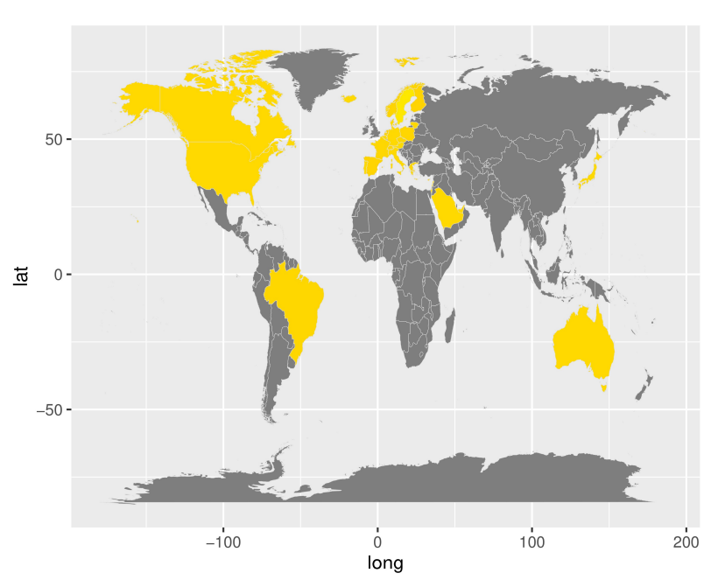
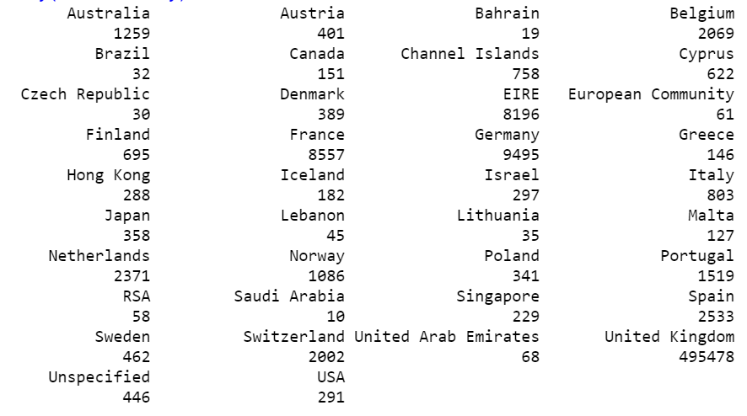
Adding Maps
Easy to read
Grasp information quickly
Room for Improvement
Text vs Map
Notes:
Even though analysts need the raw data as text formats which is on the left, while presenting, sometimes, numbers are not needed. In such case, we can use the Map to plot. The text data on the left and Color map on the right convey the same but with one glance we can understand map easily.

Slide 12
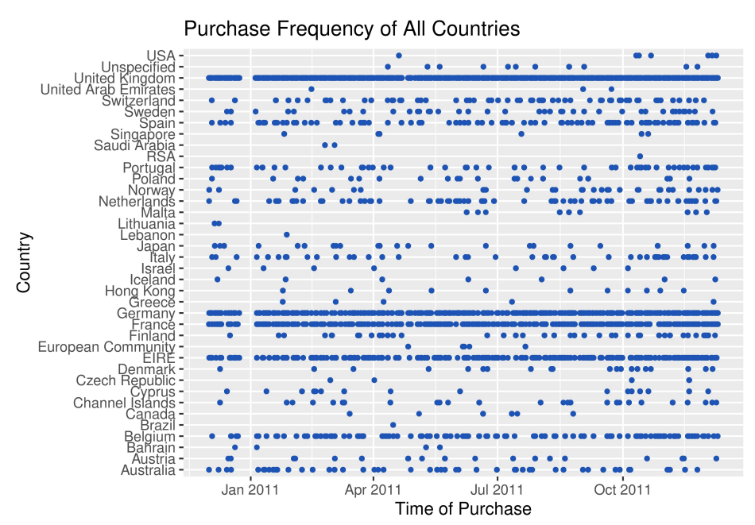
Summary
Whole data
Jan – No Purchase
Year End Purchases
Notes:
This is the last graph which gives overview of the purchases. With this, we can say that countries like Brazil purchased only once. The graph is also dense on the right side pointing that more purchases are made at the end. In Jan Two Thousand Eleven, We don’t have any purchase from whole data and we can say that there would have been a technical issue or similar making the customers unable to purchase

Slide 13
Thank you
Venu Gopalan K T
11613143
Notes:
So, these are few conclusions that I drew from OnlineRetail. It was challenging while implementing maps, I was unable to fix null values, come up with strong conclusions because of unspecified data. Also, due to limited variables and variable-types, I was unable to find co-relation among the attributes.
The Bonus insight that I found is that OnlineRetail focuses more on Europe as most of the entries are from the Europe Region and the countries with a lot of entries are from Europe

